Slide 1
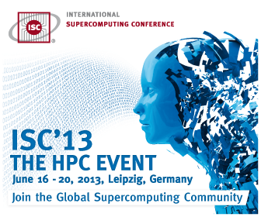
MAGMA: Matrix Algebra on GPU and Multicore Architectures
Presented by
Hatem Ltaief
Computational Scientist
KAUST, Saudi Arabia

Slide 2
MAGMA: Accelerating LAPACK
MAGMA
Matrix algebra for GPU and multicore architecture
To provide LAPACK/ScaLAPACK on hybrid architectures
http://icl.cs.utk.edu/magma/
MAGMA BLAS
A subset of BLAS for NVIDIA GPUs
Highly optimized
Fast SYMV/GEMV/GEMM implementations for Fermi and/or Kepler
MAGMA developers & collaborators
UTK, UC Berkeley, UC Denver, INRIA (France), KAUST (Saudi Arabia)
Community effort, similarly to LAPACK/ScaLAPACK

Slide 3
MAGMA: Accelerating LAPACK
MAGMA 1.3
NVIDIA GPUs
clMAGMA 1.0
AMD GPUs
MAGMA MIC 1.0
Intel Phi Coprocessor
Future: MAGMA for mobile computing
ARM + Accelerator

Slide 4
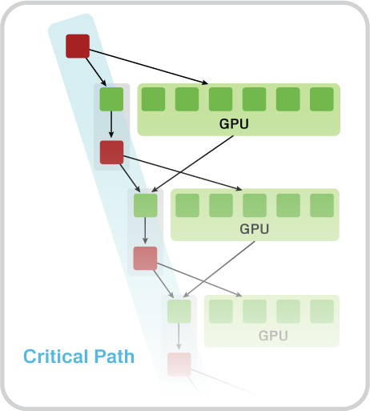
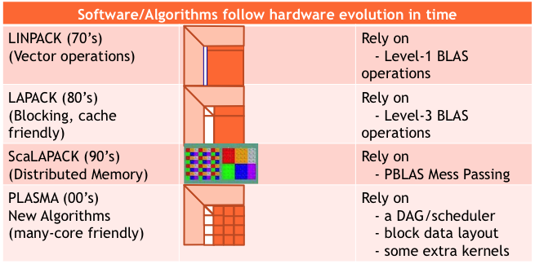
A New Generation of DLA Software
MAGMA
Hybrid Algorithms (heterogeneity friendly)
Rely on
- hybrid scheduler
- hybrid kernels

Slide 5
MAGMA Software Stack
HOST
H Y B R I D
DEVICE
distr.
Hybrid LAPACK/ScaLAPACK & Tile Algorithms / StarPU / PaRSEC
MAGMA Hybrid Tile (PLASMA) Algorithms
multi
PLASMA / Quark
StarPU run-time system
MAGMA Hybrid LAPACK and Tile Kernels
MAGMA
MAGMA SPARSE
single
MAGMA BLAS
LAPACK
BLAS
BLAS
CUDA / OpenCL / MIC
Linux, Windows, Mac OS X | C/C++, Fortran | Matlab, Python

Slide 6
Key Features of MAGMA
High performance
Multiple precision support (Z, C, D, S, and MP)
Hybrid algorithms
Out-of-device memory algorithms
Support for multiple devices
Some metrics: 80+ hybrid algorithms have been developed (total of 320+ routines)
Every algorithm is in 4 precisions (s/c/d/z)
There are 3 mixed precision algorithms (zc & ds)
These are hybrid algorithms, expressed in terms of BLAS

Slide 7
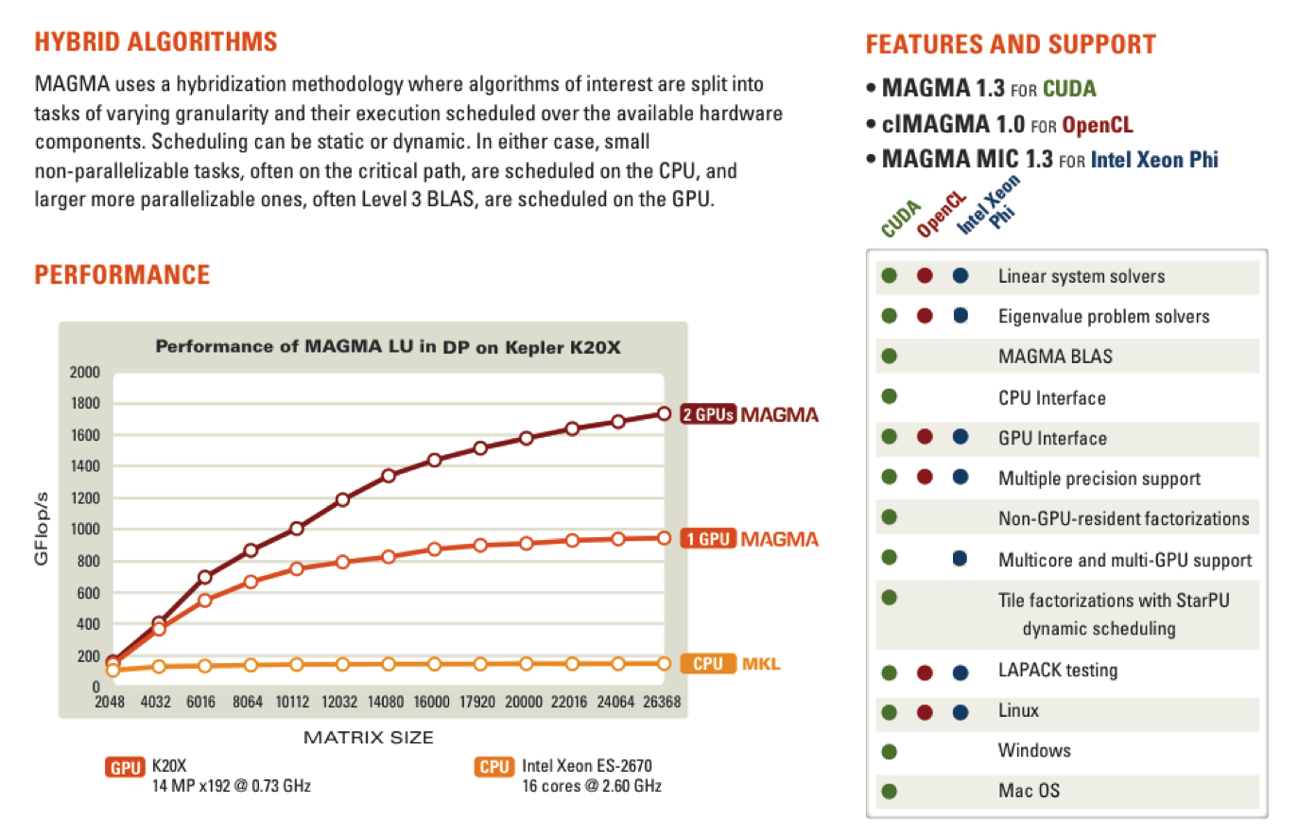
Key Features of MAGMA

Slide 8
Methodology overview
A methodology to use all available resources:
MAGMA uses hybridization methodology based on
Representing linear algebra algorithms as collections of tasks and data dependencies among them
Properly scheduling tasks' execution over multicore and GPU hardware components
Successfully applied to fundamental linear algebra algorithms
One- and two-sided factorizations and solvers
Iterative linear and eigensolvers
Productivity
1) High level; 2) Leveraging prior developments; 3) Exceeding in performance homogeneous solutions
Hybrid CPU+GPU algorithms (small tasks for multicores and large tasks for GPUs)

Slide 9
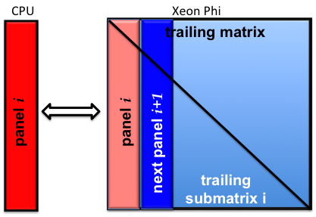
Hybrid Algorithms
One-Sided Factorizations (LU, QR, and Cholesky)
Hybridization
Panels (Level 2 BLAS) are factored on CPU using LAPACK
Trailing matrix updates (Level 3 BLAS) are done on the MIC using “look-ahead”

Slide 10
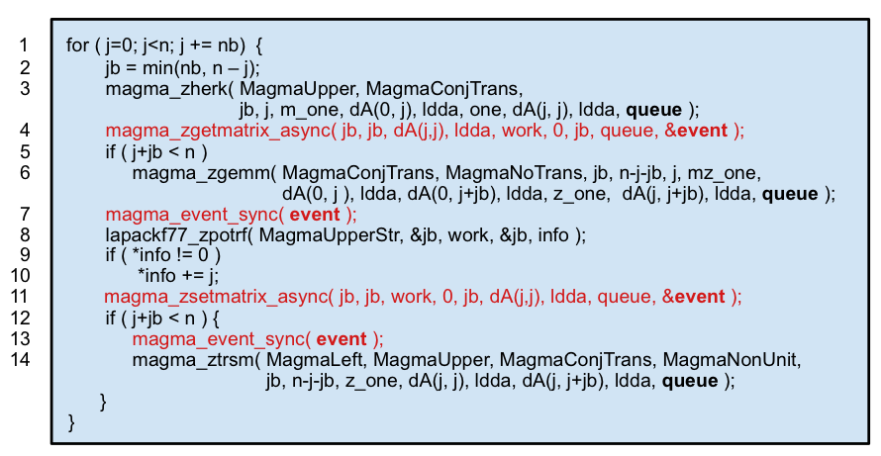
A Hybrid Algorithm Example
Left-looking hybrid Cholesky factorization in MAGMA
The difference with LAPACK – the 4 additional lines in red
Line 8 (HOST) is overlapped with work on line 6 (DEVICE)

Slide 11
Multiple precision support
Performance of the LU factorization in various precisions
GFlop/s
CPU DP peak (134 GFlop/s)
Keeneland
GPU M2090 (14 MP @1.3 GHz, peak 583 GFlop/s) CPU Intel Xeon X5660 (2x6 cores @2.8GHz)
Matrix size

Slide 12
Mixed precision iterative refinement
Solving general dense linear systems using mixed precision iterative refinement
GFlop/s
Keeneland
GPU M2090 (14 MP @1.3 GHz, peak 583 GFlop/s) CPU Intel Xeon X5660@2.80GHz (2 x 6 cores)
Matrix size

Slide 13
Mixed precision iterative refinement
Solving general dense linear systems using mixed precision iterative refinement
GFlop/s
GPU K20c (13 MP @0.7 GHz, peak 1165 GFlop/s) CPU Genuine Intel (2x8 @2.60GHz, peak 333 GFlop/s)
Matrix size

Slide 14
Out of GPU Memory Algorithms
Solving large problems that do not fit in the GPU memory
Matrices of size that do not fit in a specified GPU memory
GFlop/s
Keeneland
GPU M2090 (14 MP @1.3 GHz, peak 583 GFlop/s) CPU Intel Xeon X5660@2.80GHz (2 x 6 cores)
Matrix size

Slide 15
Out of GPU Memory Algorithms
Solving large problems that do not fit in the GPU memory
Out-of-GPU-memory Algorithms can now solve large problems
GFlop/s
Keeneland
GPU M2090 (14 MP @1.3 GHz, peak 583 GFlop/s) CPU Intel Xeon X5660@2.80GHz (2 x 6 cores)
Matrix size

Slide 16
Out of GPU Memory Algorithms
Perform left-looking factorizations on sub-matrices that fit in the GPU memory (using existing algorithms)
The rest of the matrix stays on the CPU
Left-looking versions minimize writing on the CPU
Untouched part of the matrix
Copy A₂ to the GPU
Update A₂ using A₁ (a panel of A₁ at a time)
Factor the updated A₂ using existing hybrid code
Copy factored A₂ to the CPU
Trivially extended to multiGPUs: A₂ is “larger” with 1-D block cyclic distribution, again reusing existing algorithms
To be factored sub-matrix A₂ on GPU
Factored sub-matric A₁ on CPU
. . .

Slide 17
From Single to MultiGPU Support
Data distribution
1-D block-cyclic distribution
Algorithm
GPU holding current panel is sending it to CPU
All updates are done in parallel on the GPUs
Look-ahead is done with GPU holding the next panel
nb
GPU 0
GPU 1
GPU 2
GPU 0
. . .

Slide 18
LU Factorization on multiGPUs in DP
GFlop/s
Keeneland
GPU M2090 (14 MP @1.3 GHz, peak 583 GFlop/s) CPU Intel Xeon X5660@2.80GHz (2 x 6 cores)
Matrix size

Slide 19
LU Factorization on multiGPUs in DP
GFlop/s
Keeneland
GPU M2090 (14 MP @1.3 GHz, peak 583 GFlop/s) CPU Intel Xeon X5660@2.80GHz (2 x 6 cores)
Matrix size

Slide 20
LU Factorization on multiGPUs in DP
GFlop/s
Keeneland
GPU M2090 (14 MP @1.3 GHz, peak 583 GFlop/s) CPU Intel Xeon X5660@2.80GHz (2 x 6 cores)
Matrix size

Slide 21
LU Factorization on Kepler in DP
GFlop/s
Keeneland
GPU M2090 (14 MP @1.3 GHz, peak 583 GFlop/s) CPU Intel Xeon X5660@2.80GHz (2 x 6 cores)
Matrix size

Slide 22
LU Scalability on Kepler in DP
GFlop / s
CPU: Intel Xeon ES-2670 [ 16 cores @2.60 GHz ]
GPU: K20X [ 14 MP x192 @0.73 GHz ]
Matrix size

Slide 23
LU Scalability on Kepler in DP
GFlop / s
CPU: Intel Xeon ES-2670 [ 16 cores @2.60 GHz ]
GPU: K20X [ 14 MP x192 @0.73 GHz ]
Matrix size

Slide 24
Intel Xeon Phi specific considerations
Intel Xeon Phi coprocessors (vs GPUs) are less dependent on host [ can login on the coprocessor, develop, and run programs in native mode]
There is no high-level API similar to CUDA/OpenCL facilitating Intel Xeon Phi’s use from the host *
There is pragma API but it may be too high-level for HP numerical libraries
We used Intel Xeon Phi’s Low Level API (LLAPI) to develop MAGMA API [allows us to uniformly handle hybrid systems]
* OpenCL 1.2 support is available for Intel Xeon Phi as of Intel SDK XE 2013 Beta

Slide 25
MAGMA MIC programming model
Intel Xeon Phi acts as coprocessor
On the Intel Xeon Phi, MAGMA runs a “server”
Communications are implemented using LLAPI
Host
Intel Xeon Phi
Main ( )
server ( )
LLAPI
PCIe

Slide 26
A Hybrid Algorithm Example
Left-looking hybrid Cholesky factorization in MAGMA
The difference with LAPACK – the 4 additional lines in red
Line 8 (HOST) is overlapped with work on line 6 (DEVICE)

Slide 27
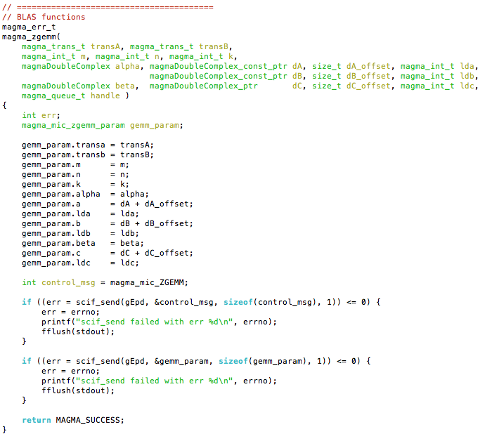
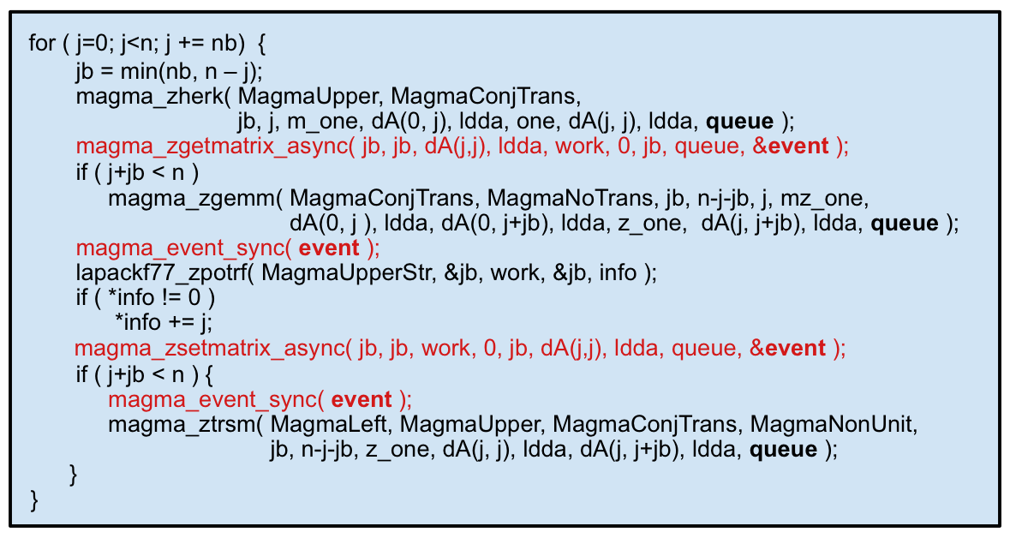
MAGMA MIC programming model
Intel Xeon Phi interface
Host program
Send asynchronous requests to the MIC;
Queued & Executed on the MIC

Slide 28
MAGMA MIC Performance ( QR )
Host Sandy Bridge (2 x 8 @2.6 GHz) DP Peak 332 GFlop/s
Coprocessor Intel Xeon Phi ( 60 @ 1.09 GHz) DP Peak 1046 GFlop/s System DP Peak 1378 GFlop/s MPSS 2.1.4346-16 compiler_xe_2013.1.117

Slide 29
MAGMA MIC Performance (Cholesky)
Host Sandy Bridge (2 x 8 @2.6 GHz) DP Peak 332 GFlop/s
Coprocessor Intel Xeon Phi ( 60 @ 1.09 GHz) DP Peak 1046 GFlop/s System DP Peak 1378 GFlop/s MPSS 2.1.4346-16 compiler_xe_2013.1.117

Slide 30
MAGMA MIC Performance (LU)
Host Sandy Bridge (2 x 8 @2.6 GHz) DP Peak 332 GFlop/s
Coprocessor Intel Xeon Phi ( 60 @ 1.09 GHz) DP Peak 1046 GFlop/s System DP Peak 1378 GFlop/s MPSS 2.1.4346-16 compiler_xe_2013.1.117

Slide 31
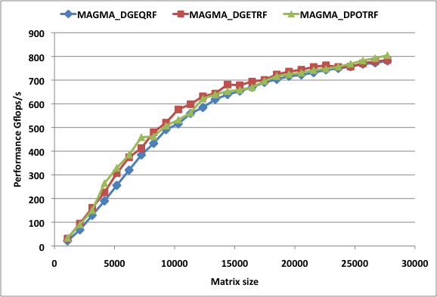
MAGMA MIC Performance
Host Sandy Bridge (2 x 8 @2.6 GHz) DP Peak 332 GFlop/s
Coprocessor Intel Xeon Phi ( 60 @ 1.09 GHz) DP Peak 1046 GFlop/s System DP Peak 1378 GFlop/s MPSS 2.1.4346-16 compiler_xe_2013.1.117

Slide 32
From Single to MultiMIC Support
Data distribution
1-D block-cyclic distribution
Algorithm
MIC holding current panel is sending it to CPU
All updates are done in parallel on the MICs
Look-ahead is done with MIC holding the next panel
nb
MIC 0
MIC 1
MIC 2
MIC 0
. . .

Slide 33
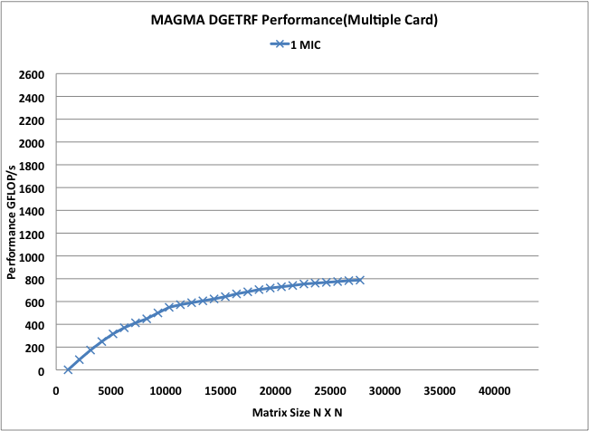
MAGMA MIC Scalability LU Performance in DP
Host Sandy Bridge (2 x 8 @2.6 GHz) DP Peak 332 GFlop/s
Coprocessor Intel Xeon Phi ( 60 @ 1.09 GHz) DP Peak 1046 GFlop/s System DP Peak 1378 GFlop/s MPSS 2.1.4346-16 compiler_xe_2013.1.117

Slide 34
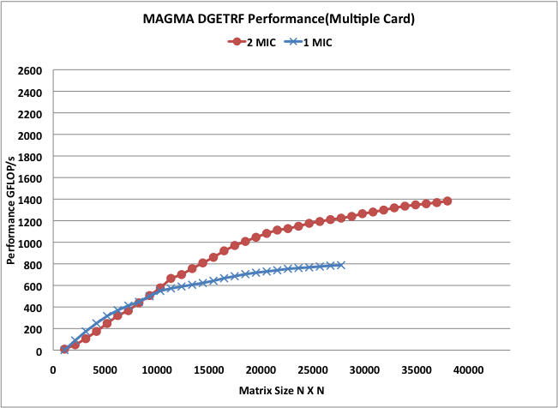
MAGMA MIC Scalability LU Performance in DP
Host Sandy Bridge (2 x 8 @2.6 GHz) DP Peak 332 GFlop/s
Coprocessor Intel Xeon Phi ( 60 @ 1.09 GHz) DP Peak 1046 GFlop/s System DP Peak 1378 GFlop/s MPSS 2.1.4346-16 compiler_xe_2013.1.117

Slide 35
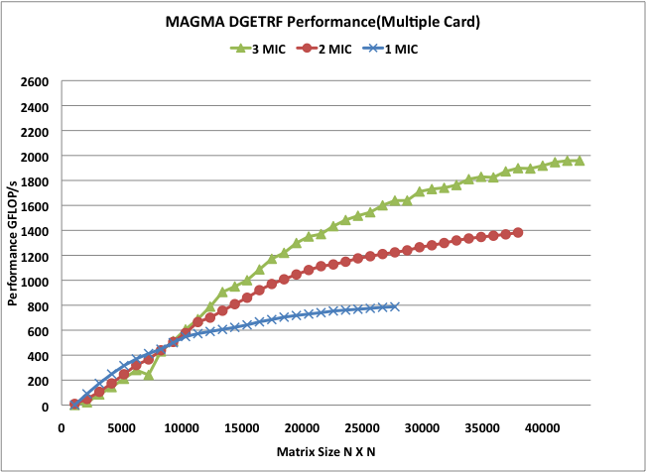
MAGMA MIC Scalability LU Performance in DP
Host Sandy Bridge (2 x 8 @2.6 GHz) DP Peak 332 GFlop/s
Coprocessor Intel Xeon Phi ( 60 @ 1.09 GHz) DP Peak 1046 GFlop/s System DP Peak 1378 GFlop/s MPSS 2.1.4346-16 compiler_xe_2013.1.117

Slide 36
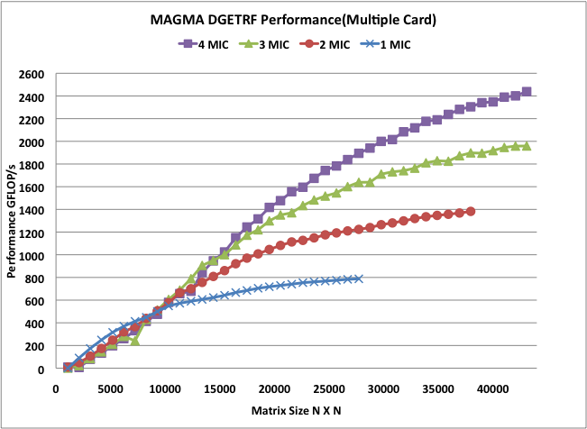
MAGMA MIC Scalability LU Performance in DP
Host Sandy Bridge (2 x 8 @2.6 GHz) DP Peak 332 GFlop/s
Coprocessor Intel Xeon Phi ( 60 @ 1.09 GHz) DP Peak 1046 GFlop/s System DP Peak 1378 GFlop/s MPSS 2.1.4346-16 compiler_xe_2013.1.117

Slide 37
MAGMA MIC Scalability QR Performance in DP
Host Sandy Bridge (2 x 8 @2.6 GHz) DP Peak 332 GFlop/s
Coprocessor Intel Xeon Phi ( 60 @ 1.09 GHz) DP Peak 1046 GFlop/s System DP Peak 1378 GFlop/s MPSS 2.1.4346-16 compiler_xe_2013.1.117

Slide 38
MAGMA MIC Scalability Cholesky Performance in DP
Host Sandy Bridge (2 x 8 @2.6 GHz) DP Peak 332 GFlop/s
Coprocessor Intel Xeon Phi ( 60 @ 1.09 GHz) DP Peak 1046 GFlop/s System DP Peak 1378 GFlop/s MPSS 2.1.4346-16 compiler_xe_2013.1.117

Slide 39
A Hybrid Algorithm Example
Left-looking hybrid Cholesky factorization in MAGMA
The difference with LAPACK – the 4 additional lines in red
Line 8 (HOST) is overlapped with work on line 6 (DEVICE)

Slide 40
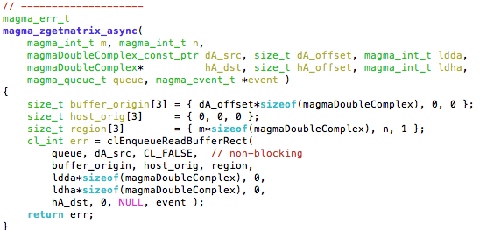
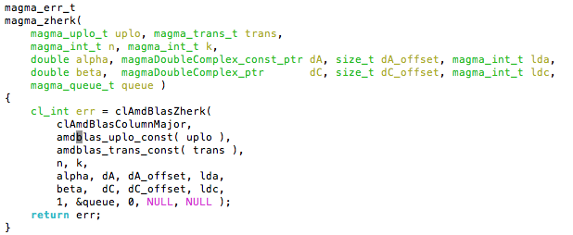
Programming Model
OpenCL interface – communications
Host program
Host program
OpenCL interface – AMD APPML BLAS

Slide 41
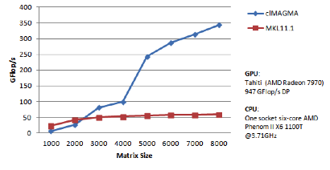
Performance of clMAGMA Cholesky Factorization in double precision

Slide 42
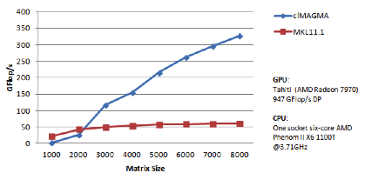
Performance of clMAGMA LU Factorization in double precision

Slide 43
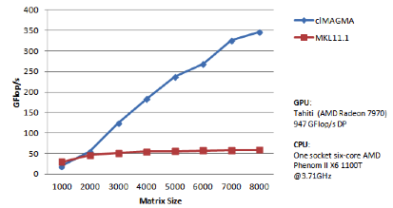
Performance of clMAGMA QR Factorization in double precision

Slide 44
Hybrid Algorithms
Two-Sided Factorizations (to bidiagonal, tridiagonal, and upper Hessenberg forms) for eigen- and singular-value problems
Hybridization
Trailing matrix updates (Level 3 BLAS) are done on the GPU (similar to the one-sided factorizations)
Panels (Level 2 BLAS) are hybrid
operations with memory footprint restricted to the panel are done on CPU
The time consuming matrix-vector products involving the entire trailing matrix are done on the GPU

Slide 45
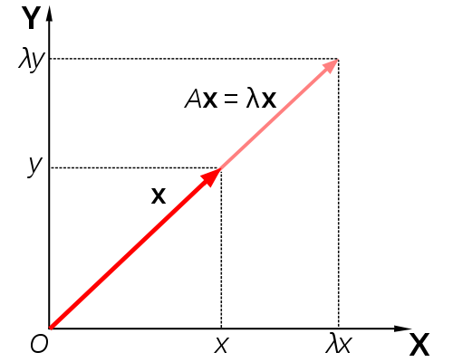
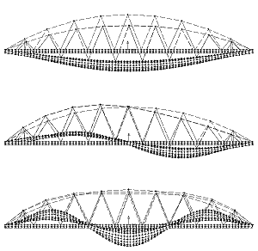
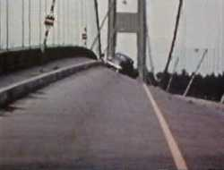
Eigenproblem Solvers in MAGMA
A x = λ x
Quantum mechanics (Schrödinger equation)
Quantum chemistry
Principal component analysis (in data mining)
Vibration analysis (of mechanical structures)
Image processing, compression, face recognition
Eigenvalues of graph, e.g., in Google’s page rank . . .
Need to solve it fast Current MAGMA results: MAGMA with 1 GPU can be 12x faster vs vendor libraries on state-of-art multicore systems
T. Dong, J. Dongarra, S. Tomov, I. Yamazaki, T. Schulthess, and R. Solca, Symmetric dense matrix-vector multiplication on multiple GPUs and its application to symmetric dense and sparse eigenvalue problems, ICL Technical report, 03/2012.
J. Dongarra, A. Haidar, T. Schulthess, R. Solca, and S. Tomov, A novel hybrid CPU- GPU generalized eigensolver for electronic structure calculations based on fine grained memory aware tasks, ICL Technical report, 03/2012.

Slide 46
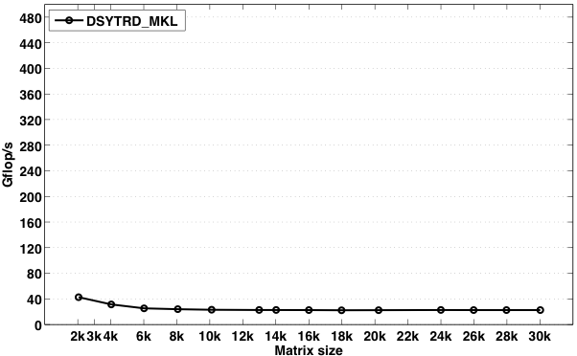
Toward fast Eigensolver
flops formula: n³/3*time
Higher is faster
Keeneland system, using one node
3 NVIDIA GPUs (M2090@ 1.1 GHz, 5.4 GB)
2 x 6 Intel Cores (X5660 @ 2.8 GHz, 23 GB)
Characteristics
Too many Blas-2 op,
Relies on panel factorization,
➔Bulk sync phases,
➔Memory bound algorithm.
A. Haidar, S. Tomov, J. Dongarra, T. Schulthess, and R. Solca, A novel hybrid CPU-GPU generalized eigensolver for electronic structure calculations based on fine grained memory aware tasks, ICL Technical report, 03/2012.

Slide 47
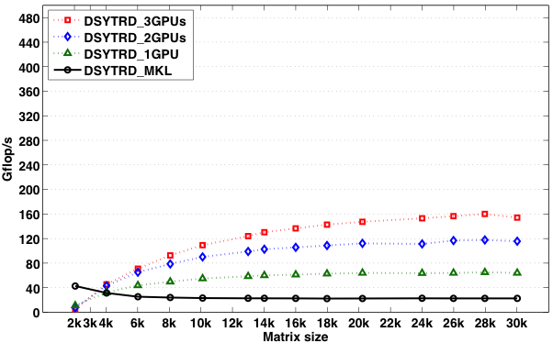
Toward fast Eigensolver
flops formula: n³/3*time
Higher is faster
Keeneland system, using one node
3 NVIDIA GPUs (M2090@ 1.1 GHz, 5.4 GB)
2 x 6 Intel Cores (X5660 @ 2.8 GHz, 23 GB)
Characteristics
Blas-2 GEMV moved to the GPU,
Accelerate the algorithm by doing all BLAS-3 on GPU,
➔Bulk sync phases,
➔Memory bound algorithm.
A. Haidar, S. Tomov, J. Dongarra, T. Schulthess, and R. Solca, A novel hybrid CPU-GPU generalized eigensolver for electronic structure calculations based on fine grained memory aware tasks, ICL Technical report, 03/2012.

Slide 48
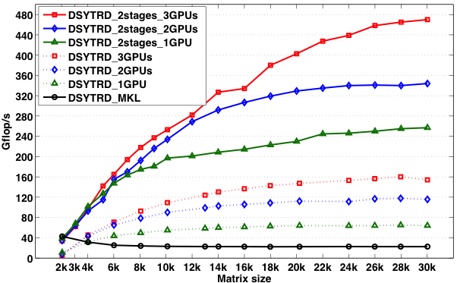
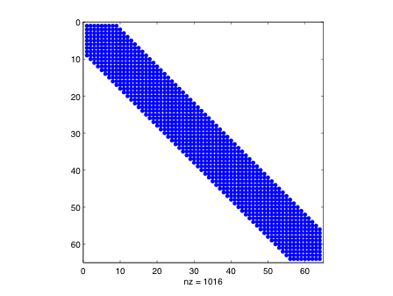
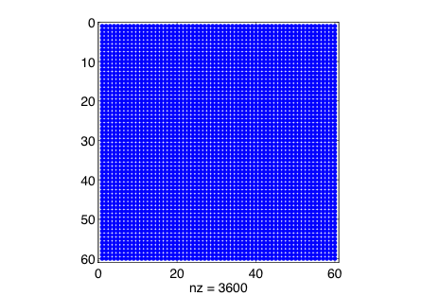
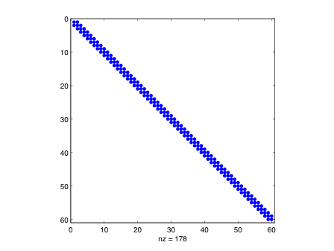
Toward fast Eigensolver
flops formula: n³/3*time
Higher is faster
Keeneland system, using one node
3 NVIDIA GPUs (M2090@ 1.1 GHz, 5.4 GB)
2 x 6 Intel Cores (X5660 @ 2.8 GHz, 23 GB)
first
stage
Characteristics
Stage 1: BLAS-3, increasing computational intensity,
Stage 2: BLAS-1.5, new cache friendly kernel,
4X/12X faster than standard approach,
Bottelneck: if all Eigenvectors are required, it has 1 back transformation extra cost.
second
stage
A. Haidar, S. Tomov, J. Dongarra, T. Schulthess, and R. Solca, A novel hybrid CPU-GPU generalized eigensolver for electronic structure calculations based on fine grained memory aware tasks, ICL Technical report, 03/2012.

Slide 49
MAGMA MIC Performance (Hessenberg)
Host Sandy Bridge (2 x 8 @2.6 GHz) DP Peak 332 GFlop/s
Coprocessor Intel Xeon Phi ( 60 @ 1.09 GHz) DP Peak 1046 GFlop/s System DP Peak 1378 GFlop/s MPSS 2.1.4346-16 compiler_xe_2013.1.117

Slide 50
From Static to Dynamic Scheduling …
Static may stall in situations where work is available
Hand tuned optimizations
Hardware heterogeneity
Kernel heterogeneity
Separation of concerns
Dynamic Runtime System

Slide 51
Current work Dynamic Scheduling
Conceptually similar to out-of-order processor scheduling because it has:
Dynamic runtime DAG scheduler
Out-of-order execution flow of fine-grained tasks
Task scheduling as soon as dependencies are satisfied
Producer-Consumer
Data Flow Programming Model
The DAG approach
Scheduling is data driven
Inherently parallel

Slide 52
Matrices Over Runtime Systems at Exascale (MORSE)
Mission statement: "Design dense and sparse linear algebra methods that achieve the fastest possible time to an accurate solution on large-scale Hybrid systems”
Runtime challenges due to the ever growing hardware complexity
Algorithmic challenges to exploit the hardware capabilities at most
Integrated into MAGMA software stack

Slide 53
MAGMA-MORSE: x86 + multiGPUs
Lessons Learned from PLASMA!
New high performance numerical kernels
StarPU Runtime System
Both: x86 and GPUs => Hybrid Computations
Similar to LAPACK in functionality

Slide 54
High Productivity
From Sequential Nested-Loop Code to Parallel Execution
for (k = 0; k < min(MT, NT); k++){
zgeqrt(A[k;k], ...);
for (n = k+1; n < NT; n++)
zunmqr(A[k;k], A[k;n], ...);
for (m = k+1; m < MT; m++){
ztsqrt(A[k;k],,A[m;k], ...);
for (n = k+1; n < NT; n++)
ztsmqr(A[m;k], A[k;n], A[m;n], ...);
}
}

Slide 55
High Productivity
From Sequential Nested-Loop Code to Parallel Execution
for (k = 0; k < min(MT, NT); k++){
starpu_Insert_Task(&cl_zgeqrt, k , k, ...);
for (n = k+1; n < NT; n++)
starpu_Insert_Task(&cl_zunmqr, k, n, ...);
for (m = k+1; m < MT; m++){
starpu_Insert_Task(&cl_ztsqrt, m, k, ...);
for (n = k+1; n < NT; n++)
starpu_Insert_Task(&cl_ztsmqr, m, n, k, ...);
}
}

Slide 56
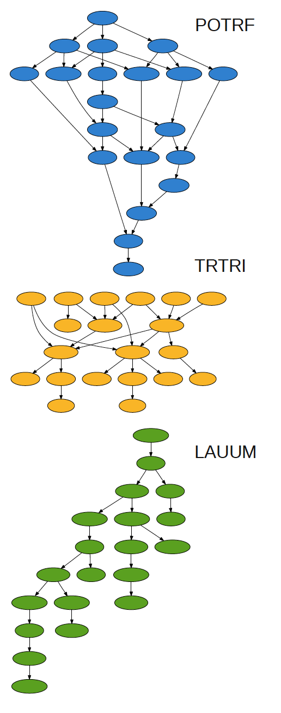
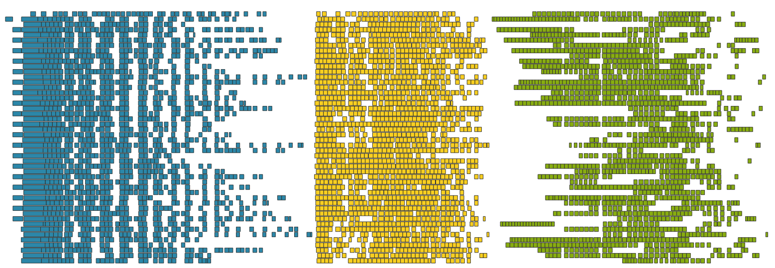
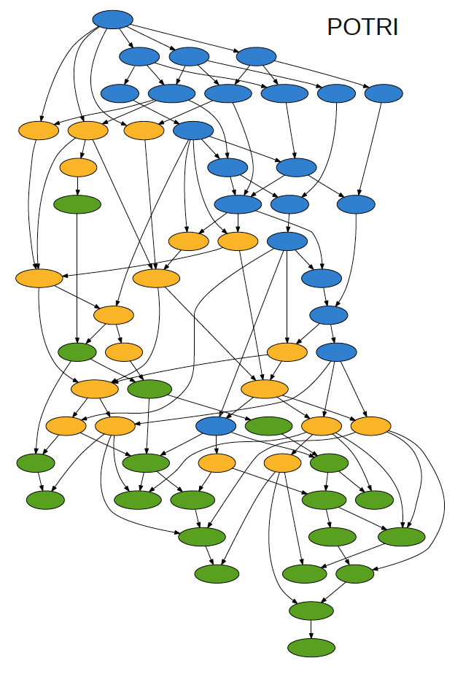
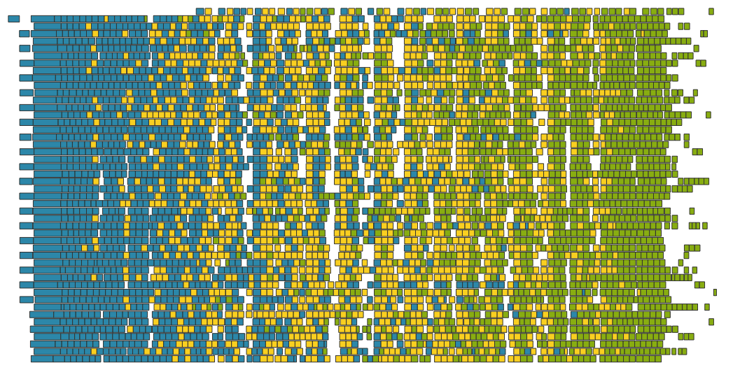
Current and Future Directions
Synchronization avoiding algorithms using Dynamic Runtime Systems
48 cores
POTRF, TRTRI and LAUUM.
The matrix is 4000 x 4000,tile size is 200 x 200

Slide 57








Contact
Stan Tomov
tomov@eecs.utk.edu
MAGMA team
http://icl.cs.utk.edu/magma
PLASMA team
http://icl.cs.utk.edu/plasma
Collaborating partners
University of Tennessee, Knoxville University of California, Berkeley University of Colorado, Denver INRIA, France (StarPU team)
KAUST, Saudi Arabia

